Slide 1
Dueling Network Architectures for Deep Reinforcement Learning
Ziyu Wang, Tom Schaul, Matteo Hessel, Hado van Hasselt, Marc Lanctot, Nando de Freitas
DeepMind
ICML 2016
2018.11.14 송석정

Slide 2
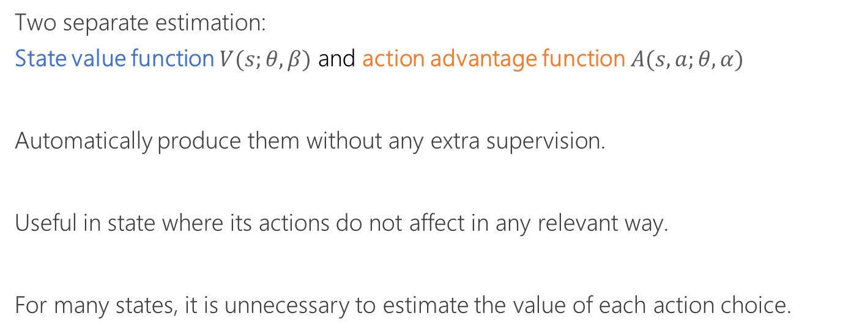
Key Points
Two separate estimation:
State value function $V(s;θ,β)$ and action advantage function $A(s,a;θ,α)$
Automatically produce them without any extra supervision.
Useful in state where its actions do not affect in any relevant way.
For many states, it is unnecessary to estimate the value of each action choice.

Slide 3
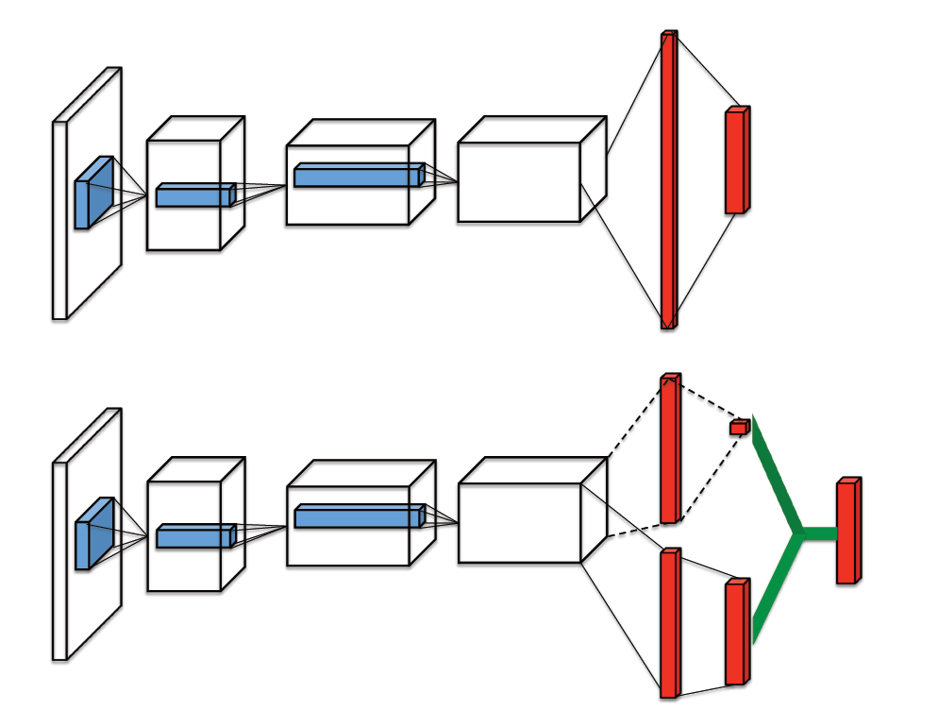
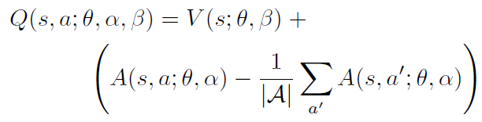



Architecture
DQN
$$Q\left(s,a;θ,α,β\right)=V\left(s;θ,β\right)+A(s,a;θ,α)$$
Dueling
$V$
$Q$
$A$

Slide 4
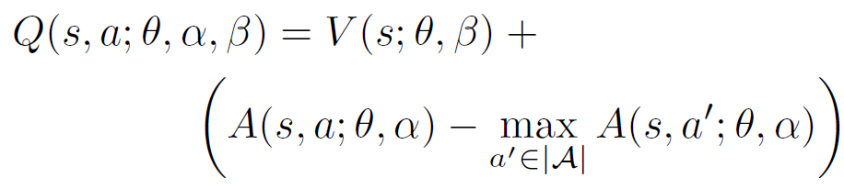
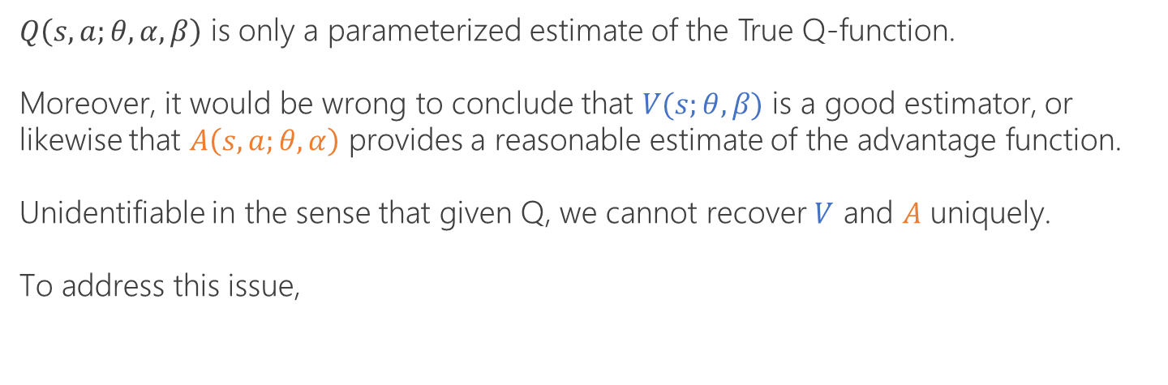
Architecture
$Q\left(s,a;θ, α,β\right)$ is only a parameterized estimate of the True Q-function.
Moreover, it would be wrong to conclude that $V(s;θ,β)$ is a good estimator, or likewise that $A\left(s,a;θ,α\right)$ provides a reasonable estimate of the advantage function.
Unidentifiable in the sense that given Q, we cannot recover $V$ and $A$ uniquely.
To address this issue,
This loses the original semantics, but it increases the stability.

Slide 5
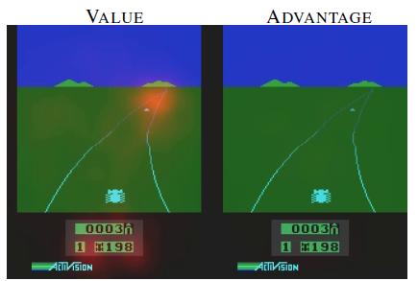
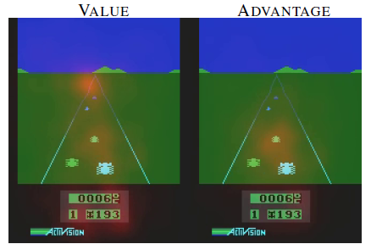
Saliency maps
The value steam pay attention to the horizon where the appearance of a car could affect future performance.
The advantage stream pay attention only when there are cars immediately in front.

Slide 6
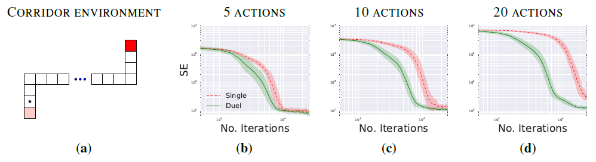
Experiments
Corridor with 5, 10 and 20 actions (no-ops)
Dueling often lead to much faster convergence than single stream in large action space.

Slide 7
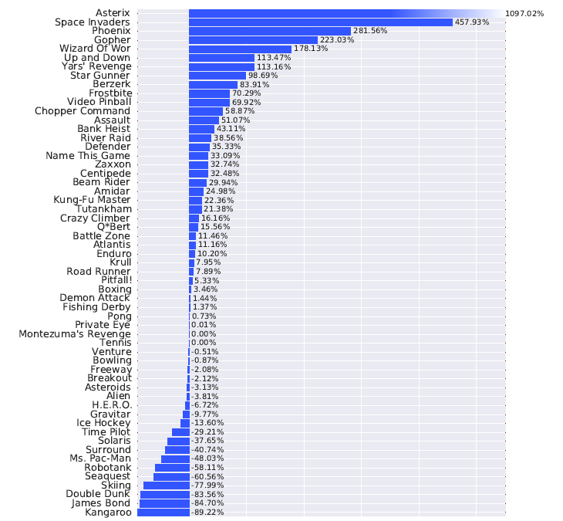
Experiments
Improvements of dueling architecture over Prioritized DDQN

Slide 8
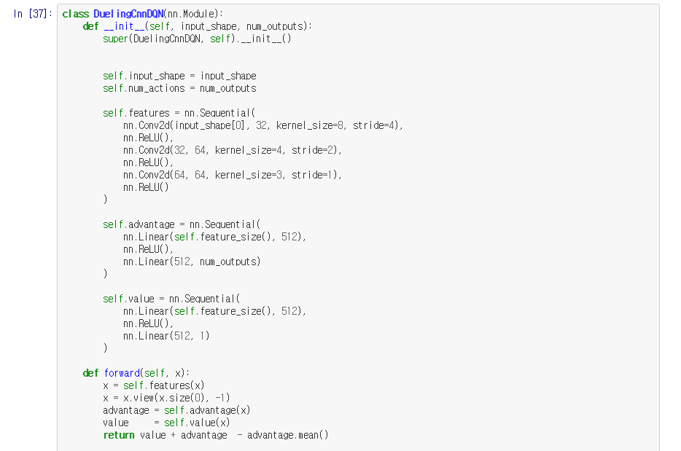
Implementation

